Slide 1
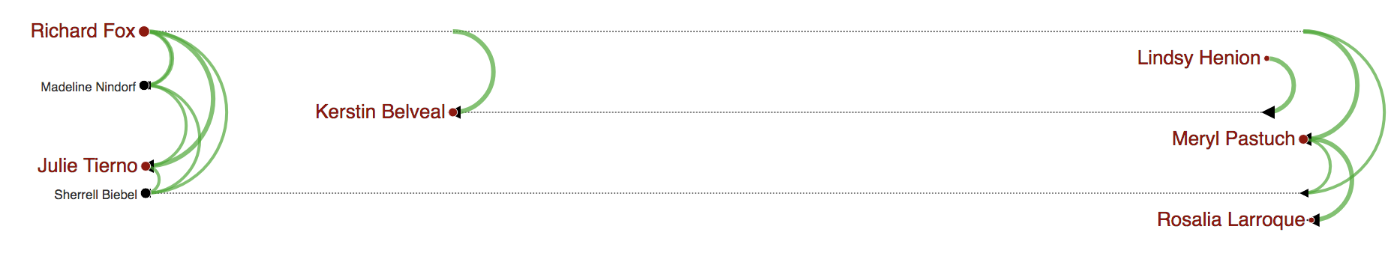
(a)
(b)
Gail Feindt

Slide 2
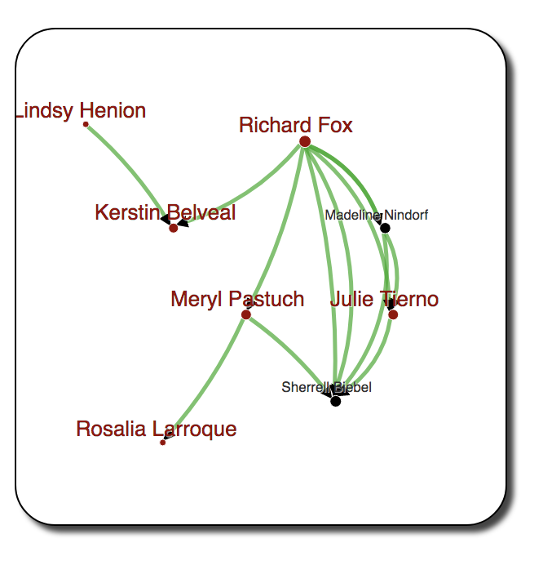
(a)
(b)
Gail Feindt

Slide 3
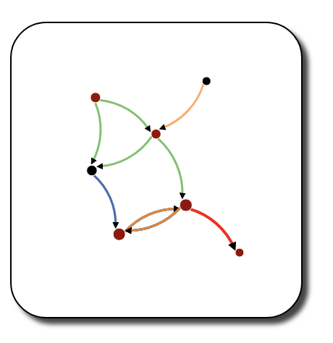
Richard Fox
Peter Fahnestock
Meryl Pastuch
Sherrell Biebel
Rosalia Larroque
Kerstin Belvea
Jenice Savaria
Jenice Savaria
(b)
(a)
Gail Feindt

Slide 4
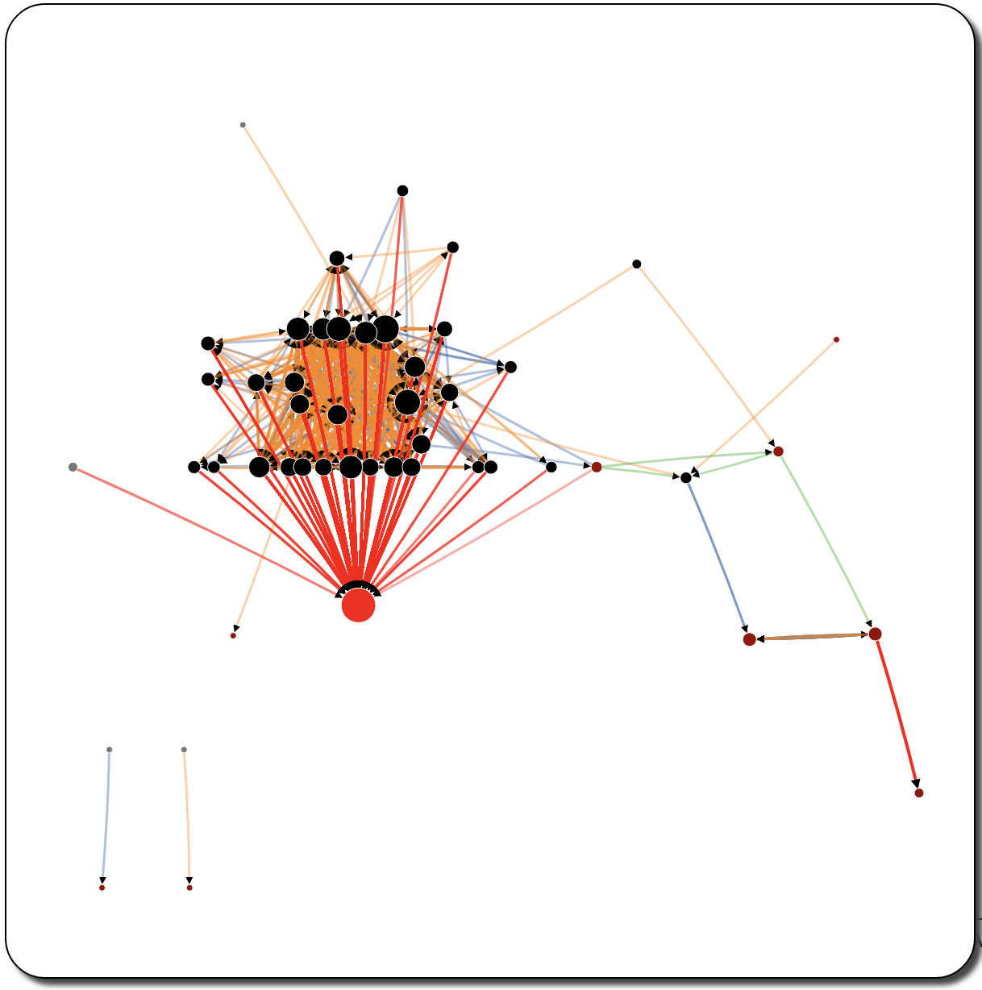
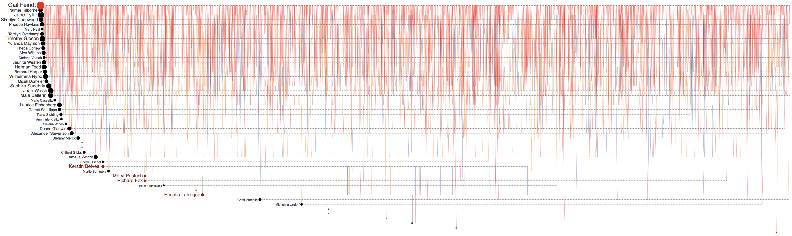
Peter Fahnestock
Meryl Pastuch
Richard Fox
Sherrell Biebel
Kerstin Belvea
Rosalia Larroque
Gail Feindt
Jenice Savaria
Jenice Savaria
(a)
(b)
Jenice Savaria

Slide 5
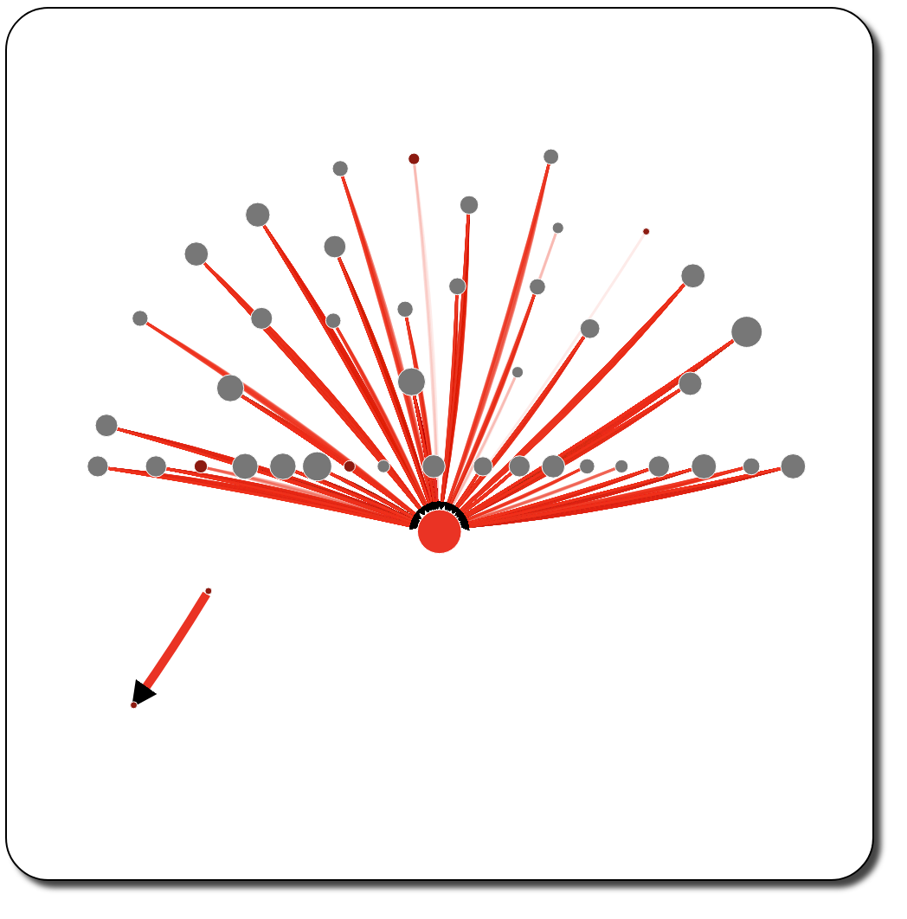
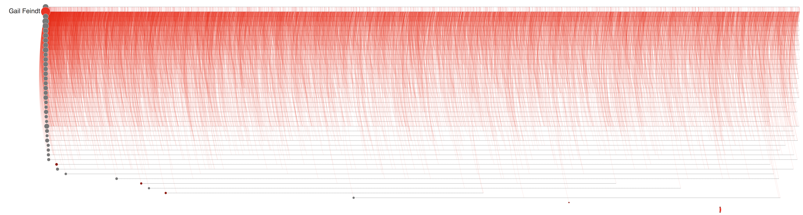


Rosalia Larroque
Jenice Savaria
(a)
(b)
Rosalia Larroque
Jenice Savaria

Slide 6
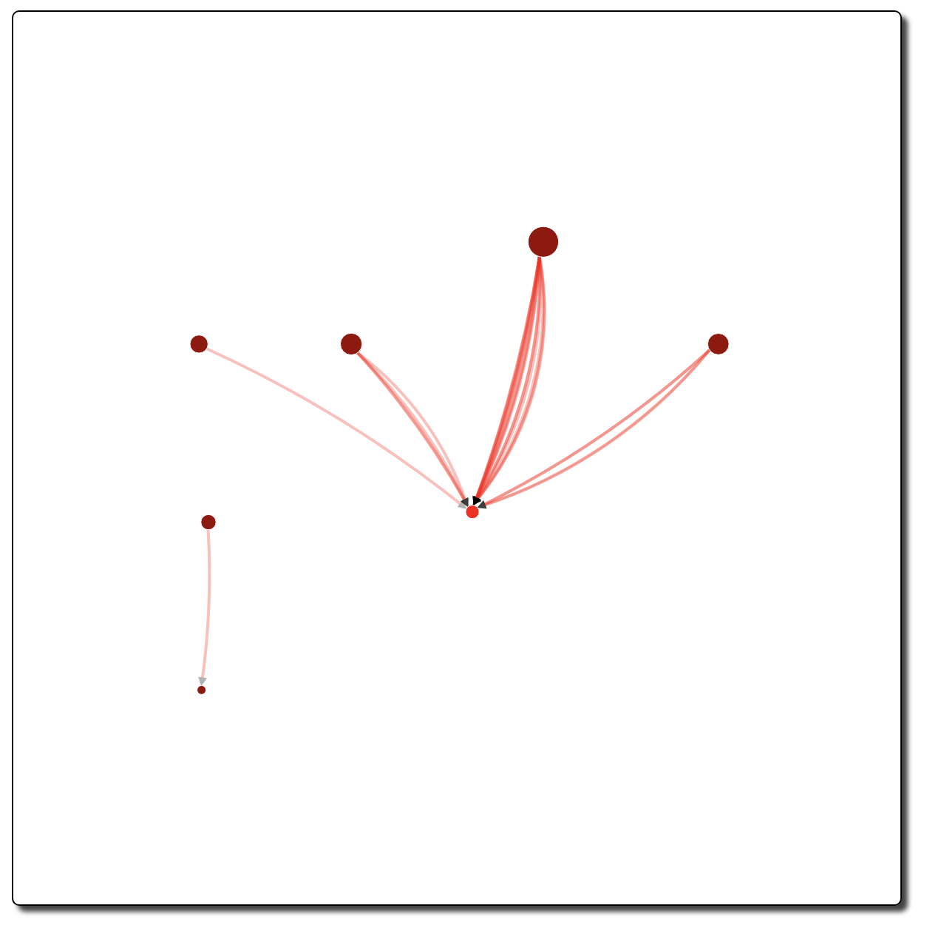
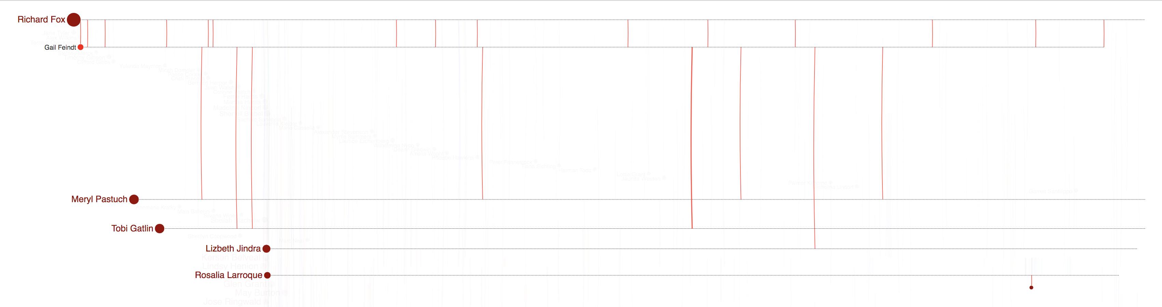
(a)
(b)

Slide 7
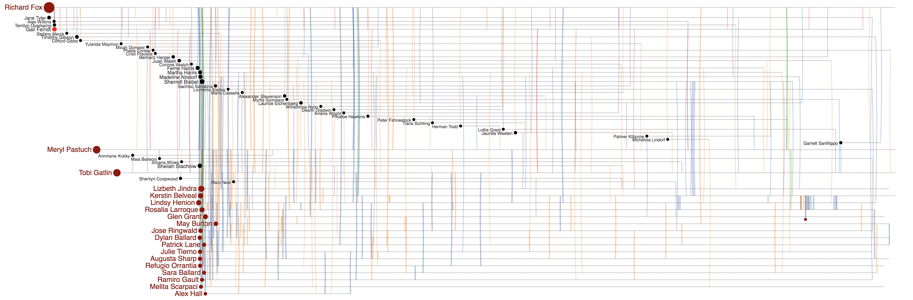
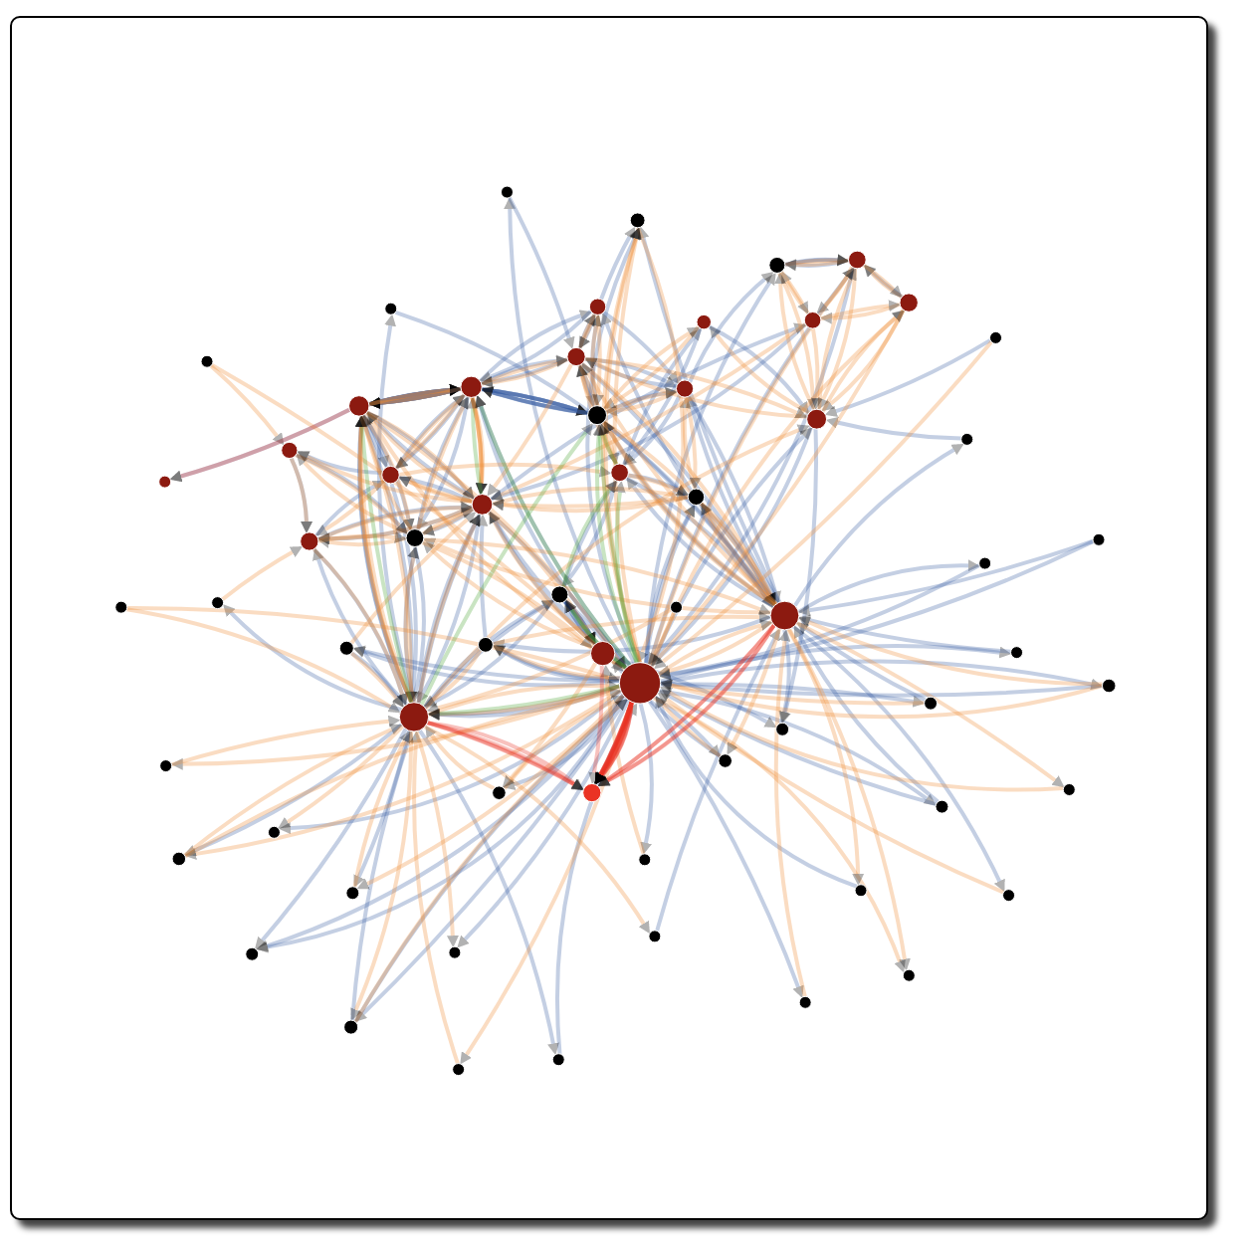
(a)
(b)

Slide 8
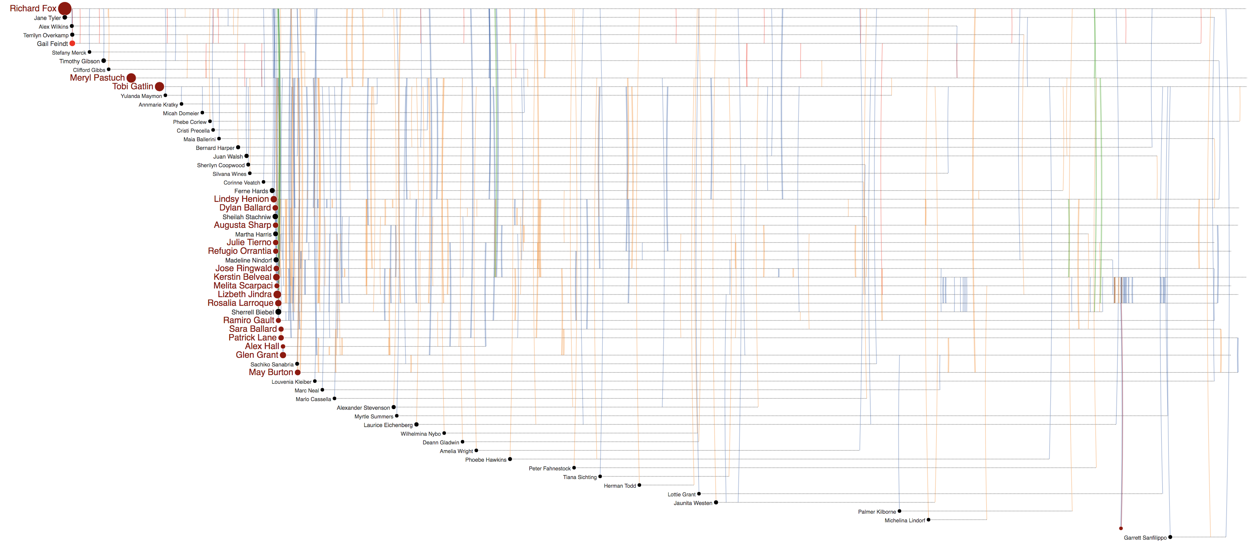
(a)
(b)

Slide 9
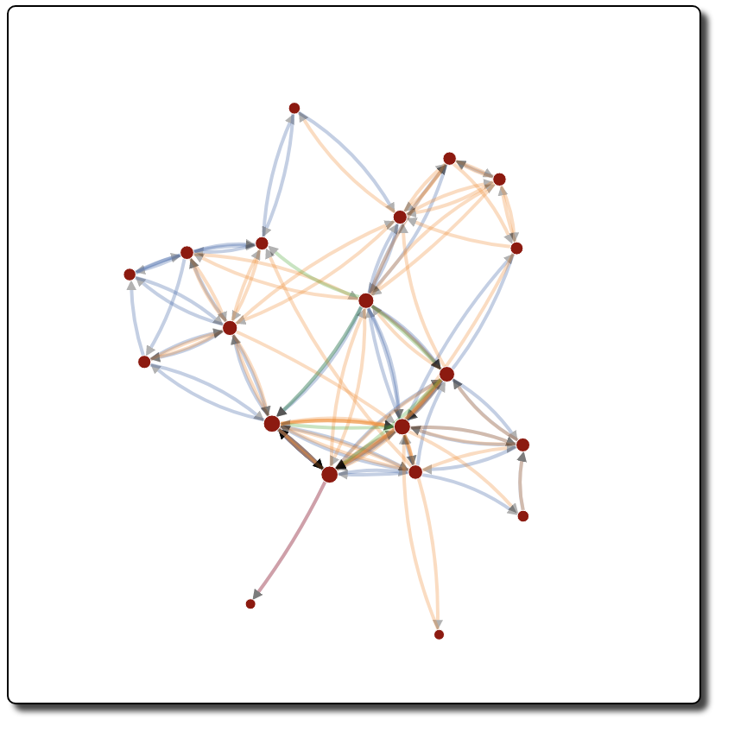
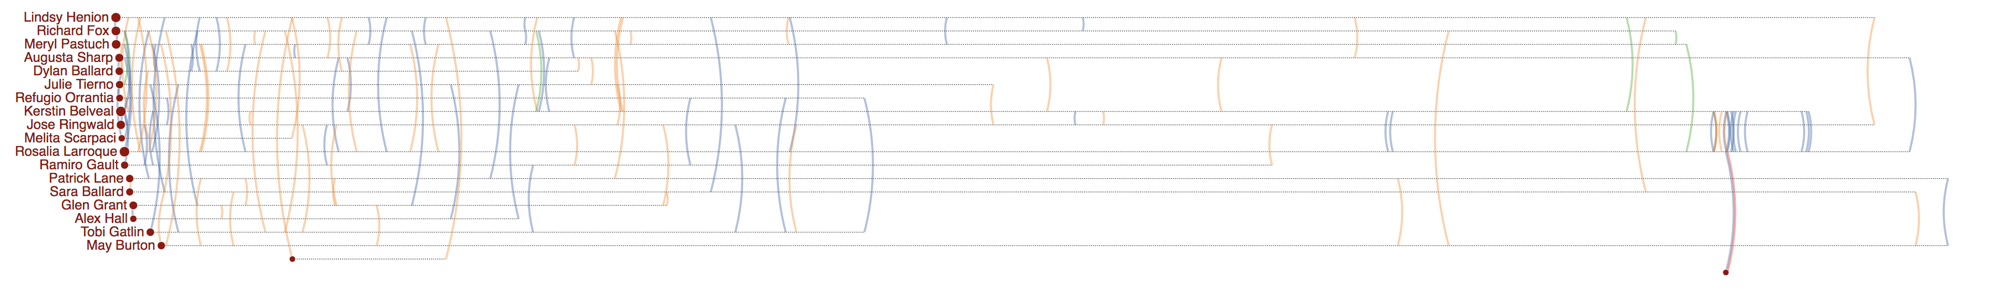
(b)
(a)

